Slide 1

VideoChat
3조 보안연대
Team David Belasco

Slide 2
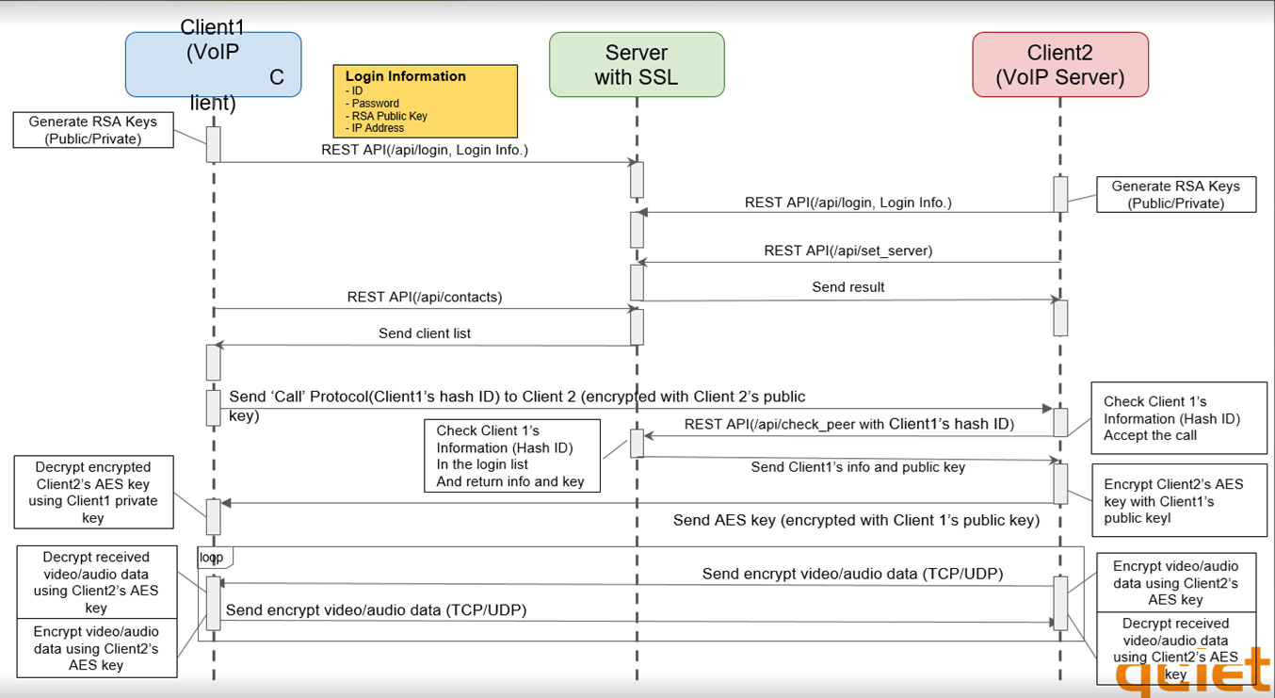
Architecture(team1 project)
call CALL_STATUS_PORT :10002
VOIP_LOCAL_PORT :10001
VIDEO_PORT :10000

Slide 3
Demo

Slide 4
Project Members and Role
Server vulnerability analysis
Robin Kim(김성준), SeKi Park(박세기)
Client vulnerability analysis
SungMin Kim(김성민), DongHoon Shin(신동훈)
Static analysis and fuzzing
JiYoung Yoon(윤지영)
Mentor / Support
David Belasco

Slide 5
Schedule
W1 |  |  | W2
Brainstorm for attack tree
Progress meeting
Server analysis
Client analysis
static analysis / fuzzing
CODE REVIEW for vulnerabilities
Collaboration Attack test
Prepare final report

Slide 6
Attack Tree
Threat :
Make an abnormal Video call State
send abnormal data to opened signal port
send fake call
send abnormal data during the call to video port
display invalid call information
taint the video data
obtain hash_id and public key information
scan open port (nmap)
CALL_STATUS_PORT 10002
VIDEO_PORT 10000
enter invalid data
retrieve the personal data from server via http request
obtain personal data from the network packet
Denial of Service:
can’t receive video call
Spoofing:
send fake video call
Mitigation applied: https used (checked using Wireshark)
terminate video call
log-in with invalid IP address
Mitigation applied :
AES Encryption/ Decryption used
(checked with Code Review)

Slide 7
Executive Summary
Top 5 vulnerabilities listed out of 12
Priority | Vulnerability | Impact | Recommendation
High (CVSS 7.5) | If hash_id and public key is known, it is possible to make fake call. (Spoofing) | Attacker can make a fake call with hash_id and public_key. | - Check and validate the caller’s IP address. - Compare real IP and IP registered in server
High (CVSS 7.5) | Any call request can be allowed. (Denial of Service) | Attacker can make a fake call infinitely | - Check and validate the caller’s IP address - Limit request count within some duration
High (CVSS 7.5) | Anyone can send the call end request. (Denial of Service) | Attacker can make a request call end infinitely Attacker can make call end during a call | - Open video port only call is received
Mid (CVSS 5.4) | All REST api is exposed. (Information disclosure) | An attacker can retrieve the personal data via http request | Remove REST api document page
Low (CVSS 3.1) | Need IP address sanitizer | Possible to log-in with invalid IP address | IP address input validation
Appendix-22

Slide 8
Evaluation Constraints - Mitigating Factors
Mitigating Factors | Descriptions
Data Encryption | Video call data should be secured in transit.
 | Sensitive data should be stored securely.
Authentication / Authorization | All users should be authenticated correctly and securely.
 | Network communications should use TLS or an equivalent encryption protocol.
 | Each user should only have the capabilities they are explicitly granted permitted to use
Secure Coding | Secure coding practices are applied to avoid common security flaws like SQL injection and buffer overflow.

Slide 9
Evaluation Constraints - Assumptions
Assumptions | Descriptions
Cryptography | Crypto APIs used are assumed to be secure. ex) RAND_bytes()
 | Crypto library providing APIs is assumed to be safe. ex) OpenSSL
Storage Security | Due to hardware constraints, credentials are assumed to be securely stored in trusted location.
 | Credentials are not left in system memory.
 | The inherent stability and security specific to currently used database are not taken into consideration.

Slide 10
Evaluation Narrative
Analysis Technique | Using Tool | Result | Vulnerability
Static Analysis X Code Review O | SonarCloud, Cppcheck | No meaningful issue | Vul-5
Web Fuzzing O | DirBuster, DIRB | Detected critical page (docs, redoc) REST api is exposed and possible to get user data. | Vul-1
Client Fuzzing X | SPIKE | Run a fuzzing test on the socket communication and found no issues. | None
Input Validation O | Code Review | Need IP address validation. (Any data is acceptable in IP addr) | Vul-5
Use Exploit Tools O | Postman, Wireshark, nmap, Kali, scapy, checksec | Postman - http request Kali - ARP spoofing checksec - CFG,RFG not present User info. is exposed with REST api. | Vul-2, Vul-3, Vul-4 Vul-6
Research Vulnerability DB X | https://www.cvedetails.com | No issue : There’s no vulnerabilities. (openssl 3.1.1, opus 1.3.1) | None
Dependency check X | Owasp dependency-check | No meaningful issue | None
Appendix-11~13
Appendix-1~4
Appendix-23
Appendix-10
Appendix-5~9
Appendix-17~21
Appendix-14
Appendix-15
** Vul : It’s defined vulnerability issue.

Slide 11
Vulnerability Reporting(1)
Num. | Summary | Location | Consequences/ Impact | CVSS Score | Proof of Concept(POC)
Vul-1 | REST api is exposed. / Network Attack | FastAPI expose REST api in docs, redoc | Attacker can retrieve user information / Information disclosure | CVSS 5.4 | https://ip:8000/docs https://ip:8000/redoc
Vul-2 | Make fake call / Client exploit | If hash_id, public_key and IP is known, it is possible to make fake call | Attacker can make the fake call / Spoofing | CVSS 7.5 | C++/Python exploit code can be made
Vul-3 | Make fake call infinitely / Client exploit | same as Vul-2 | Attacker can make the fake call infinitely / Denial of Service | CVSS 7.5 | C++/Python exploit code can be made
peer_hash_id = 'WOYXCNFRXYCVFO66'
rsa_key = 'LS0tLS1CRUdJTiBQVUJMSUMgS0VZLS0 … <snippet> ’
my_socket.connect(host, port)
encrypt_msg = my_socket.encrypt_message(rsa_key, peer_hash_id)
my_socket.send(encrypt_msg)

Slide 12
Vulnerability Reporting(2)
Num. | Summary | Location | Consequences/ Impact | CVSS Score | Proof of Concept(POC)
Vul-4 | Make fake call end infinitely / Client exploit | video port 10000 is always ready | Attacker can make the fake call end infinitely / Denial of Service | CVSS 7.5 | C++/Python exploit code can be made
Vul-5 | IP address input validation / Client attack | No IP address validation check | Can not use video call if invalid IP address entered / | CVSS 3.1 | Executable with invalid IP address
Vul-6 | Spoof Voip Server / MITM, Network Attack | Voip client does not have the process of authenticating Voip server. | Attacker can send AES keys Voip client/ Incorrect call connection or exposure of image data | CVSS 5.4 | ARP Spoofing IP Spoofing
* Exploit not complete

Slide 13
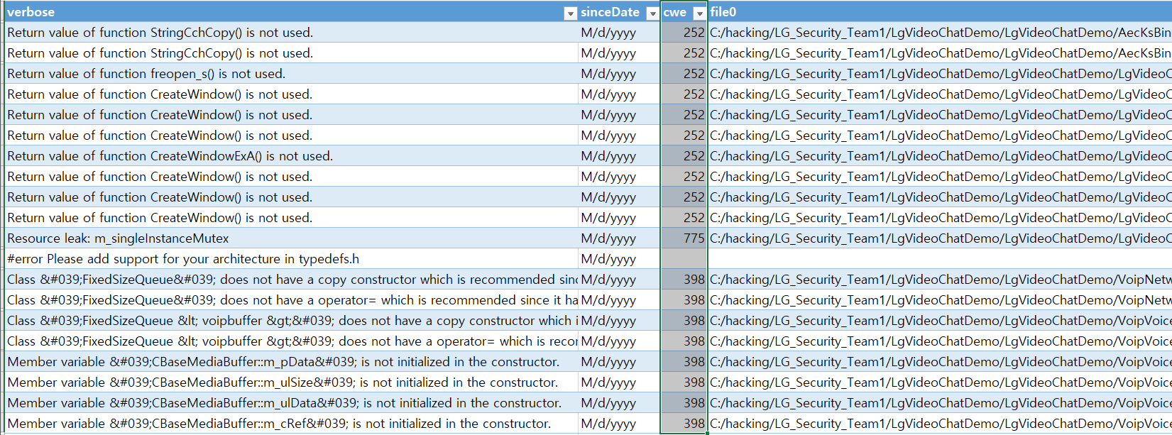
Weakness Reporting(1) - Client
Num. | Summary | Location | Consequences/ Impact | CWE number | Proof of Concept(POC)
Weak-1 | Unchecked Return Value | LgVideoChatDemo/LgVideoChatDemo/AecKsBinder.cpp line 202,203 LgVideoChatDemo/LgVideoChatDemo.cpp line 175,705, 713 | N/A | CWE-252 | If error returns, malfunction
Weak-2 | Indicator of Poor Code Quality | LgVideoChatDemo\LgVideoChatDemo\FixedSizeQueue.h line 18 LgVideoChatDemo\LgVideoChatDemo\mediabuf.h line 20 | N/A | CWE-398 | N/A
Weak-3 | Missing Release of File Descriptor Handle after Effective Lifetime | LgVideoChatDemo/LgVideoChatDemo.cpp line 925 | N/A | CWE-775 | Memory leak

Slide 14
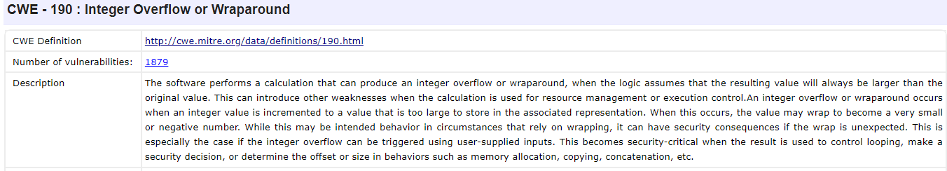
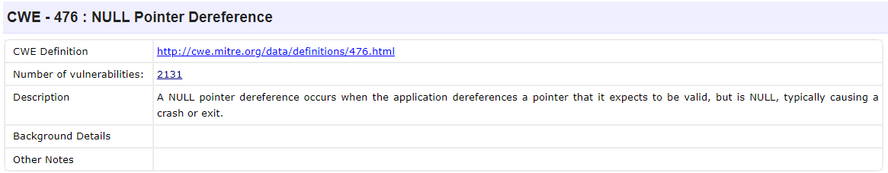
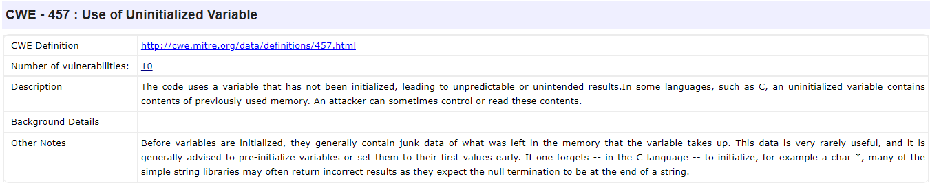
Weakness Reporting(2) - OpenCV
OpenCV has 8 CWEs, Major 3 are below

Slide 15
Conclusions and Recommendations
REST API document page must be *NOT* exposed publicly.
Authenticate and validate all requests on server-side (eg. IP check)
Rate Limiting
Set limits on number of requests per user or IP in certain time
Recommend implementing logging system
IP Reputation Lists : Blocking known malicious IPs
Least Privilege Principle to SQLite db
No password and no setting of privilege in SQLite db
Setup IDS(Intrusion Detection Systems)
monitor and alert system to detect any unusual activities

Slide 16
Reflection and Lessons Learned
Gained critical insights into security vulnerabilities, types of attacks, and the potential for exploitation
Required more experience to apply the attack techniques we have practiced in the course
What Worked Well?
All requirements are satisfied in time
Collaborated very well with each other during the project
What Didn't Work Well?
Does NOT execute GUI based Client Fuzzing (winAFL…)

Slide 17
Appendix

Slide 18
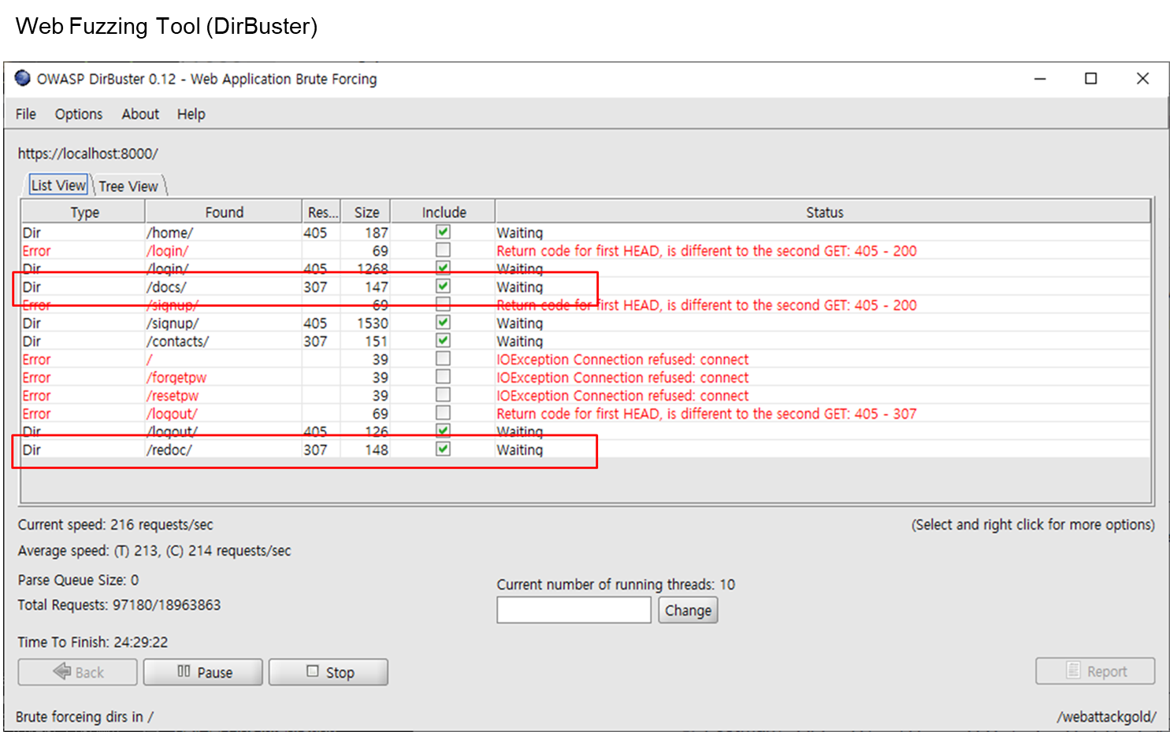
Appendix-1) DirBuster

Slide 19
Appendix-2) DIRB(1)
$ dirb https://127.0.0.1:8000
-----------------
DIRB v2.22
By The Dark Raver
-----------------
START_TIME: Tue Jun 27 22:31:01 2023
URL_BASE: https://127.0.0.1:8000/
WORDLIST_FILES: /usr/share/dirb/wordlists/common.txt
-----------------
GENERATED WORDS: 4612
---- Scanning URL: https://127.0.0.1:8000/ ----
+ https://127.0.0.1:8000/contacts (CODE:422|SIZE:175)
+ https://127.0.0.1:8000/docs (CODE:200|SIZE:953)
+ https://127.0.0.1:8000/home (CODE:307|SIZE:0)
+ https://127.0.0.1:8000/login (CODE:307|SIZE:0)
+ https://127.0.0.1:8000/logout (CODE:307|SIZE:0)
+ https://127.0.0.1:8000/signup (CODE:307|SIZE:0)
+ https://127.0.0.1:8000/static (CODE:307|SIZE:0)
-----------------
END_TIME: Tue Jun 27 22:31:08 2023
DOWNLOADED: 4612 - FOUND: 7

Slide 20
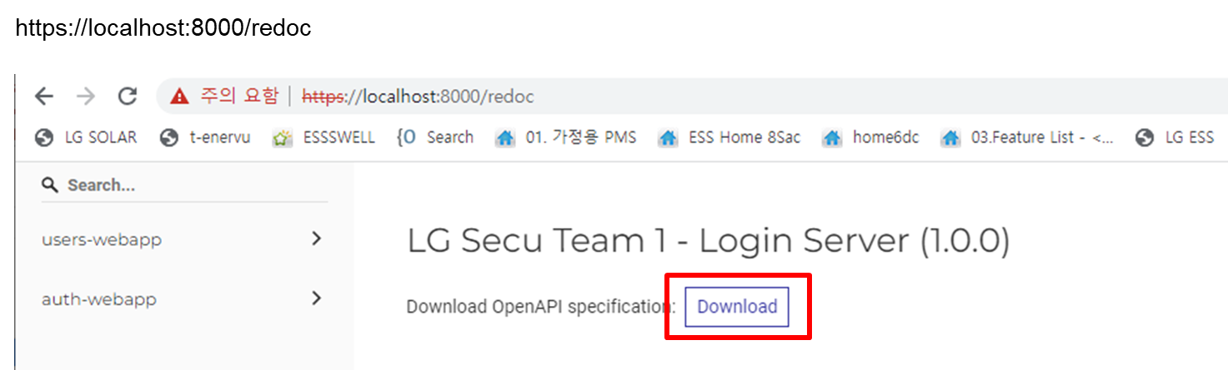
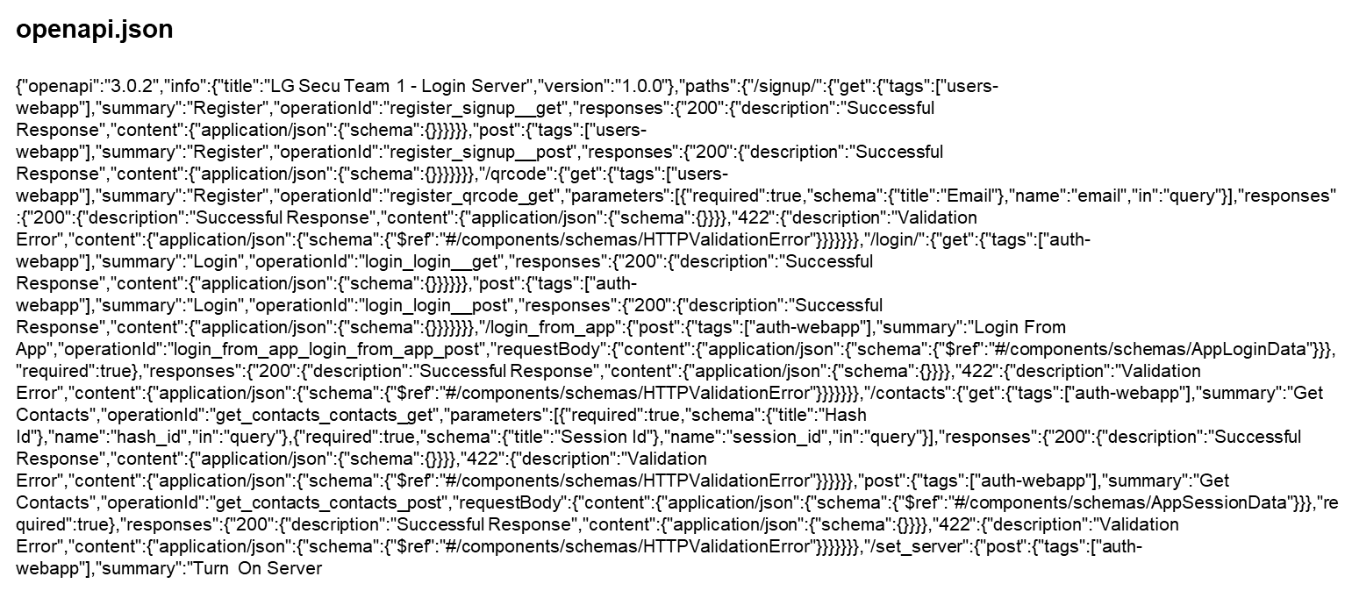
Appendix-3) DIRB(2)

Slide 21
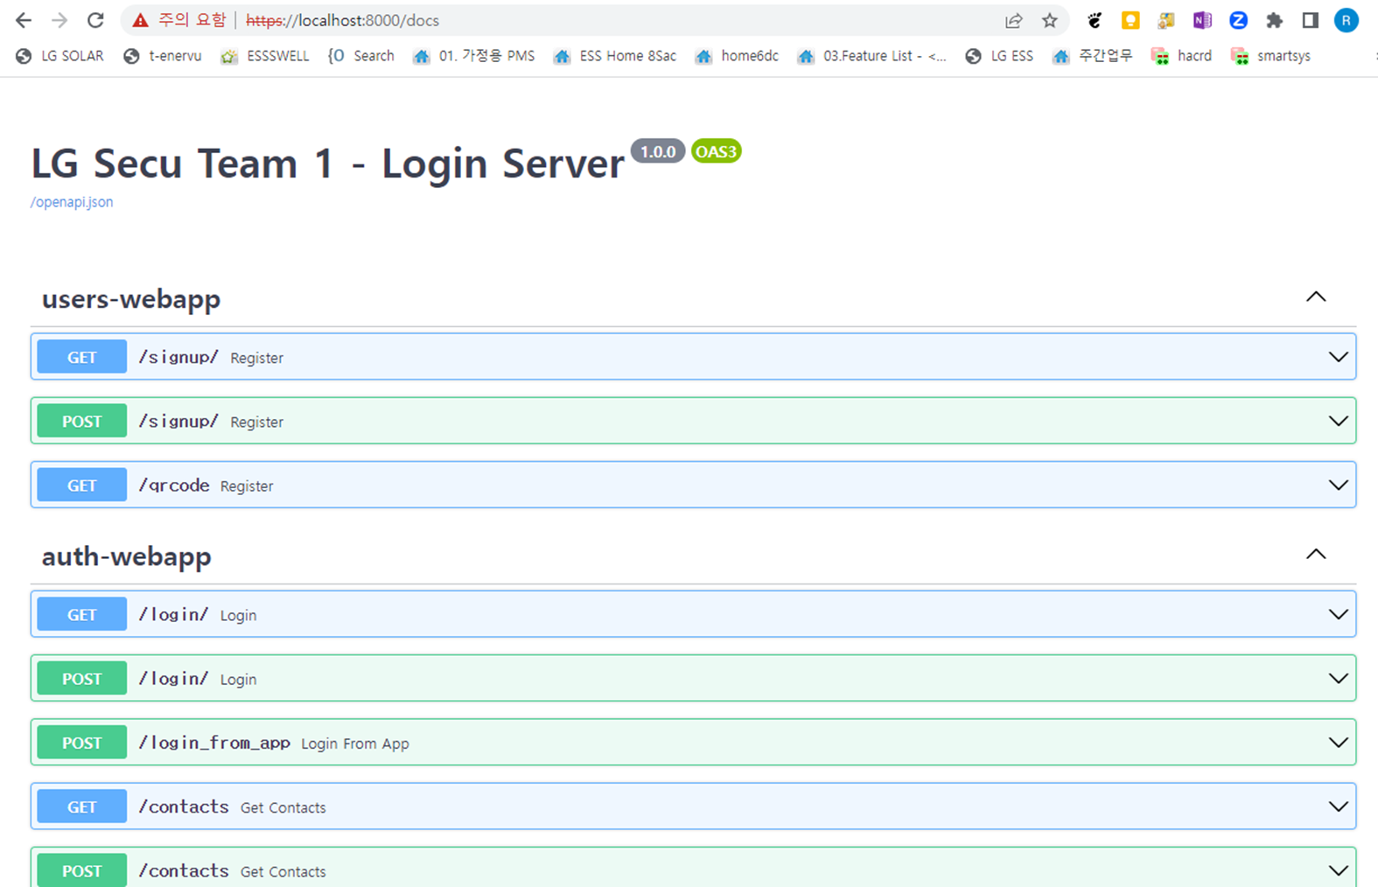
Appendix-4) DIRB(3)

Slide 22
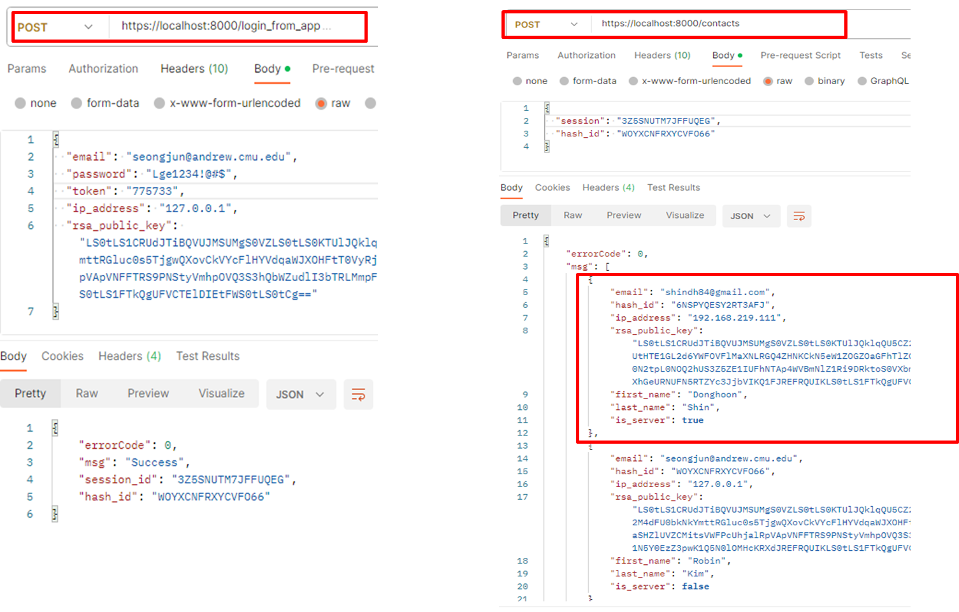
Appendix-5) Information Disclosure(Postman) - Exploit

Slide 23
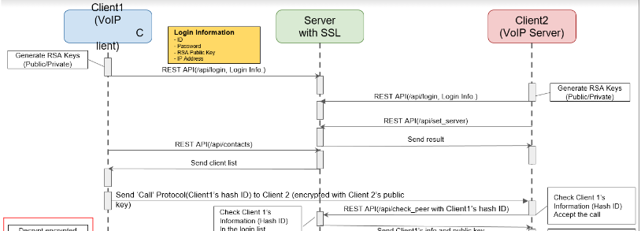
Appendix-6) Spoofing - Vulnerability
We can pretend to be someone else on the contact list with hash_id and rsa_public_key and make a call

Slide 24
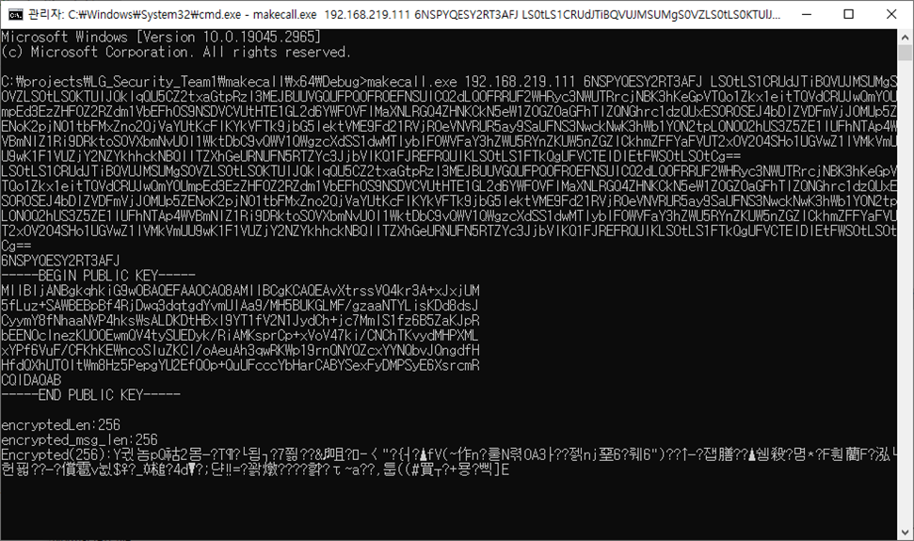
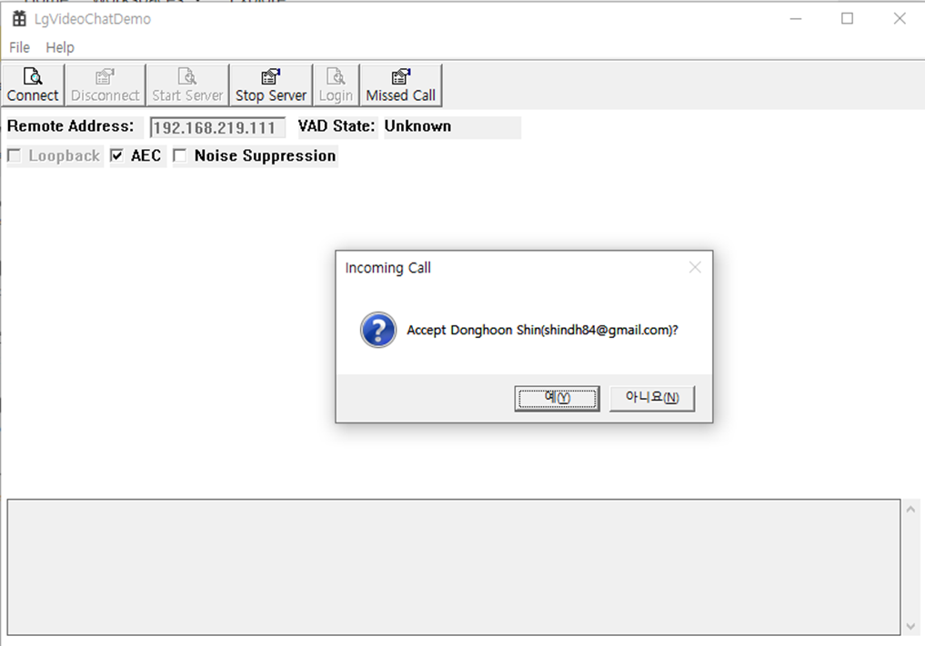
Appendix-7) Spoofing - Exploit
Exploit with hash_id and rsa_public_key for making a call

Slide 25
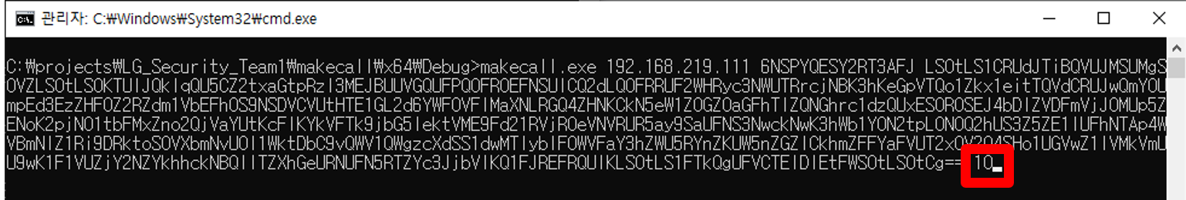
Appendix-8) Denial of Service - Vulnerability
Exploit with hash_id and rsa_public_key for making a call
Last option is count and if we keep make a call, app invoke notice popup infinitely

Slide 26
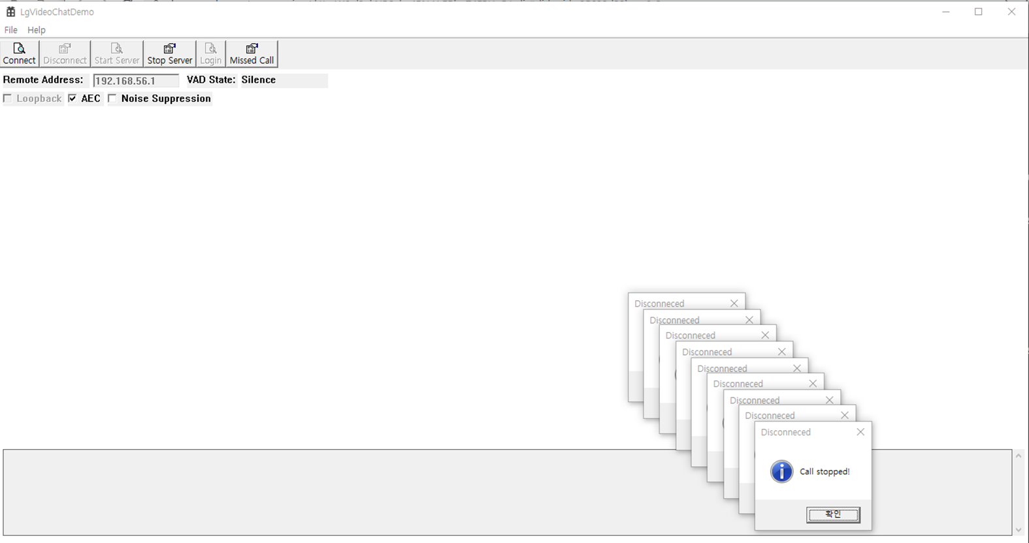
Appendix-9) Denial of Service - Exploit

Slide 27
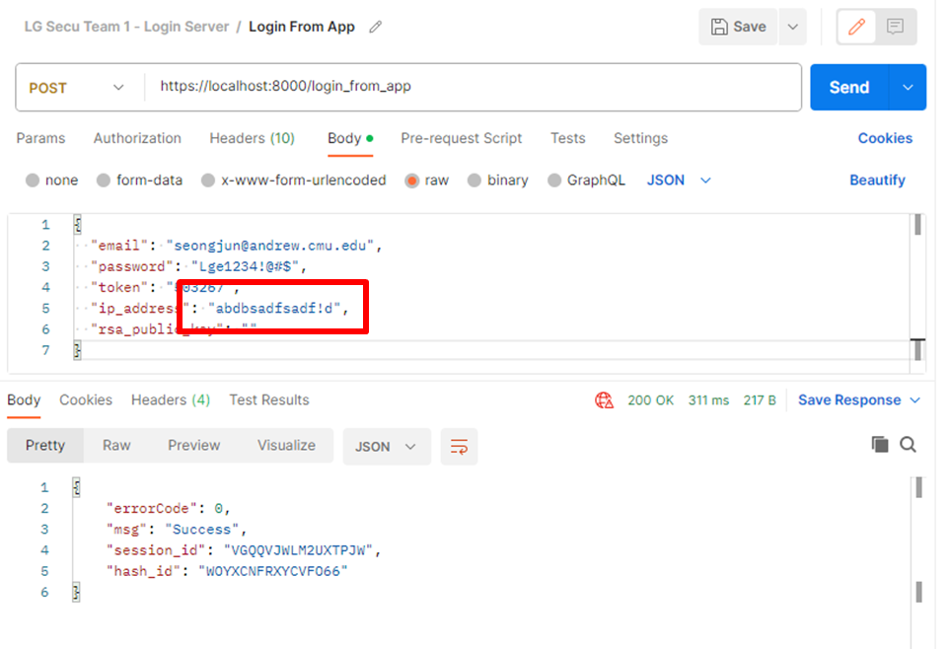
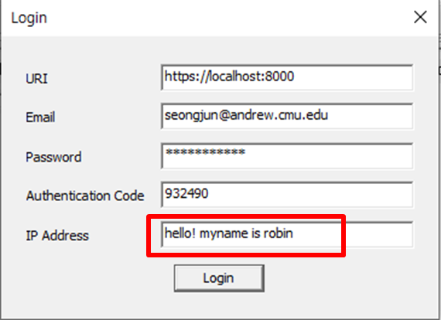

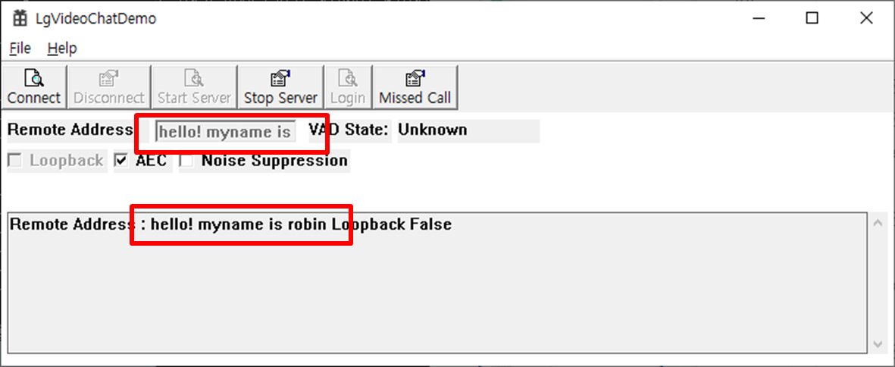
Appendix-10) Input Validation

Slide 28
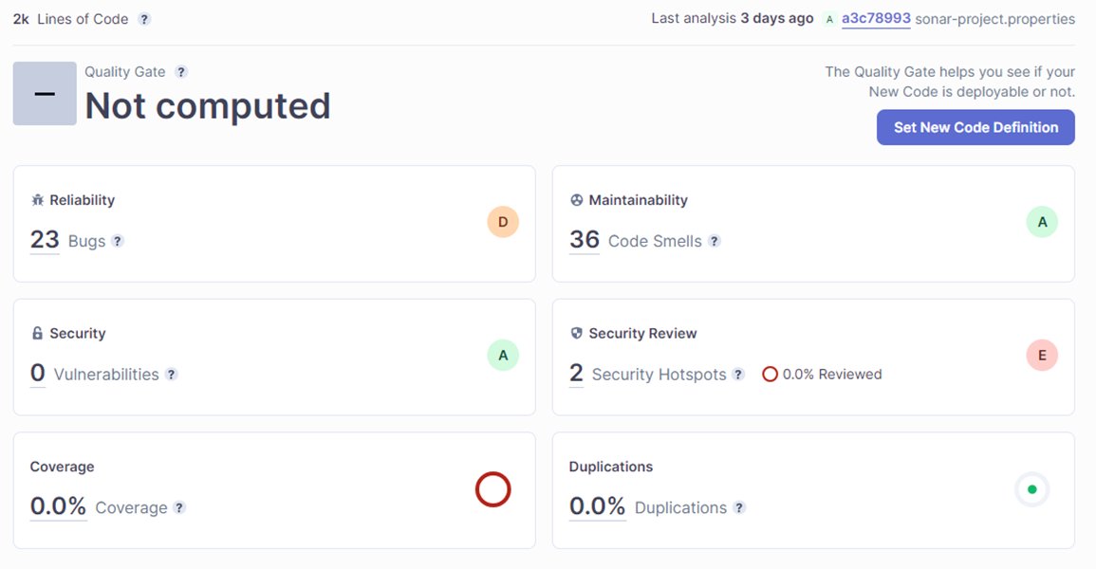
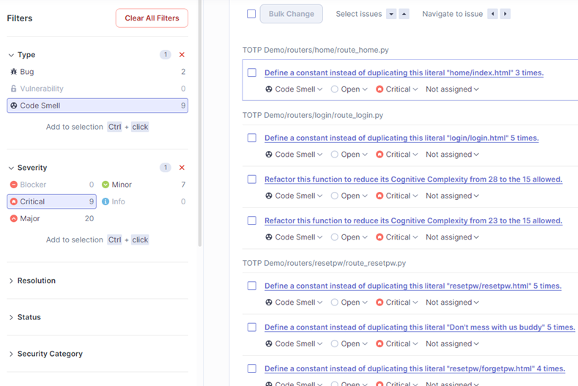
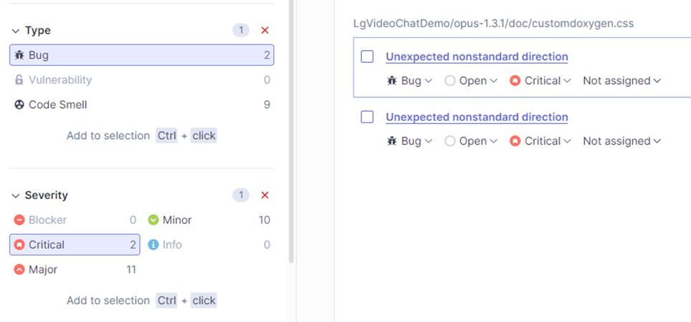
Appendix-11) Code Review- Server

Slide 29
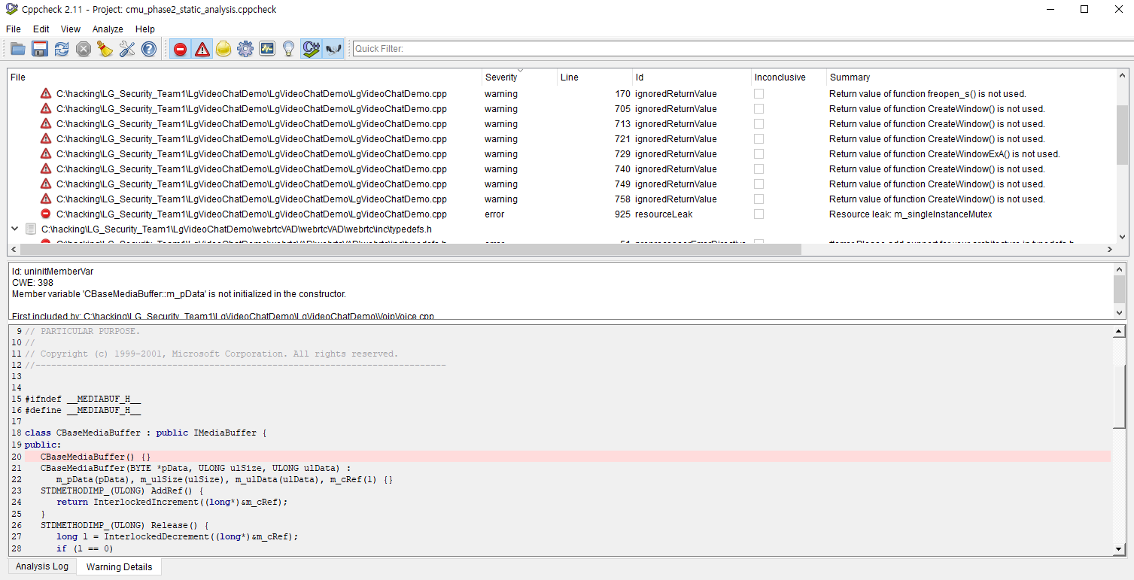
Appendix-12) Code Review- Client

Slide 30
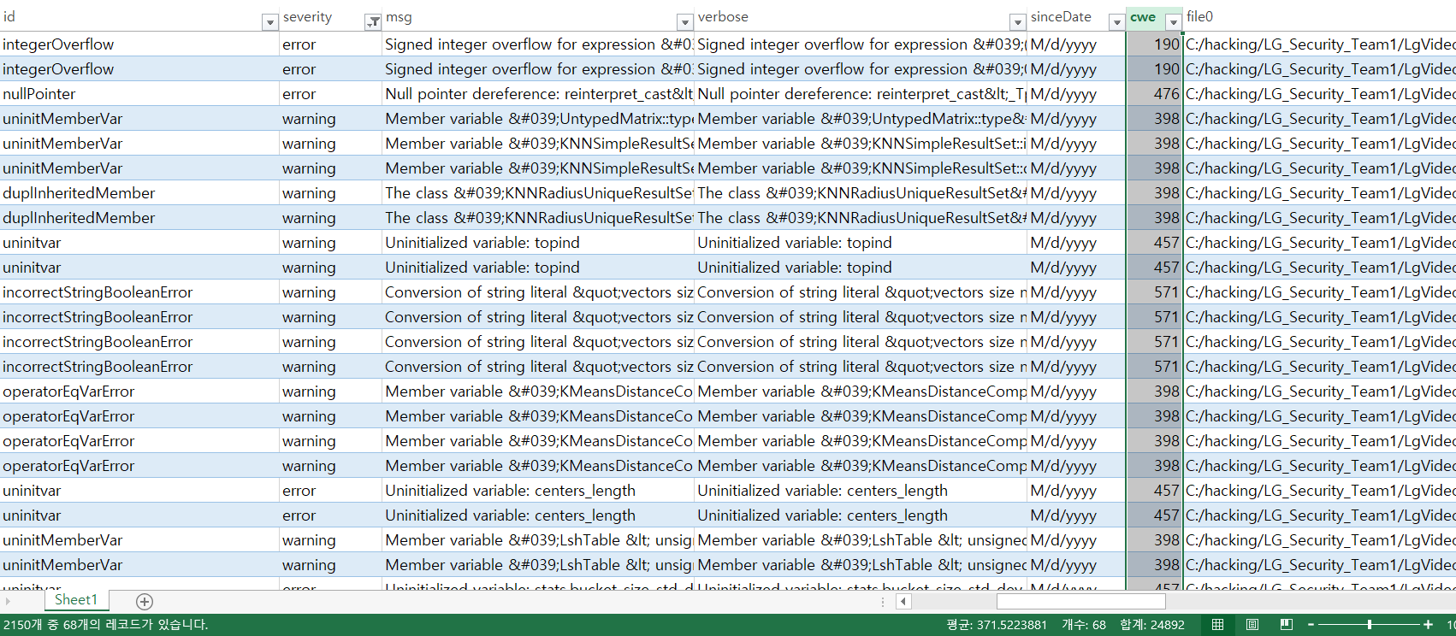
Appendix-13) Code Review(OpenCV - CWEs)
8 CWEs

Slide 31
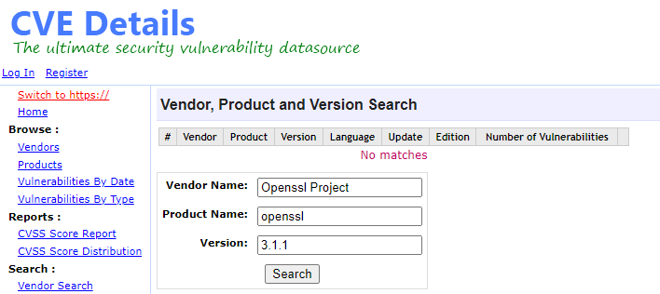
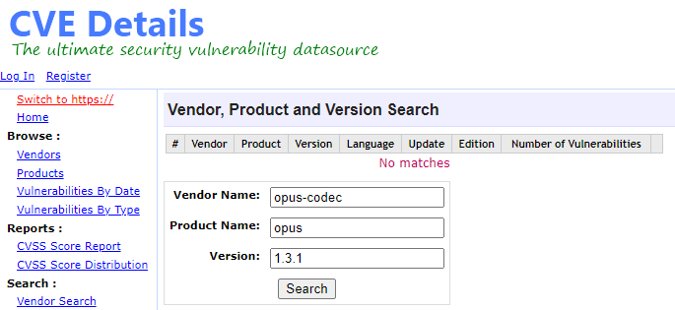
Appendix-14) Research Vulnerability DB
https://www.cvedetails.com
There’s no vulnerability

Slide 32
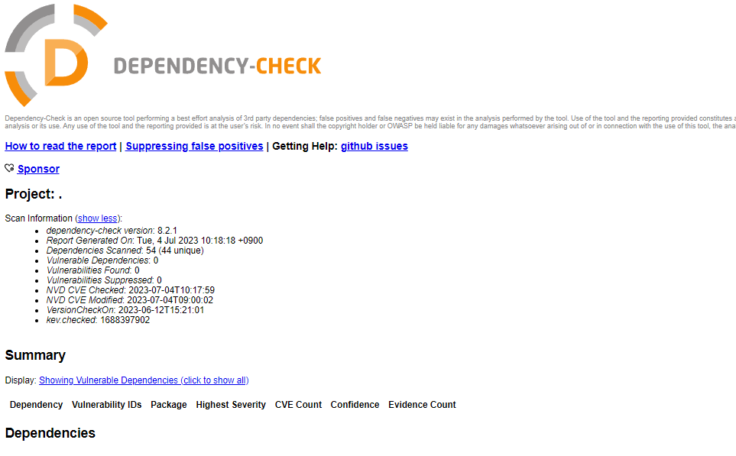
Appendix-15) Dependency-check
There’s no vulnerability

Slide 33
Attack Scenario (idea)

Slide 34
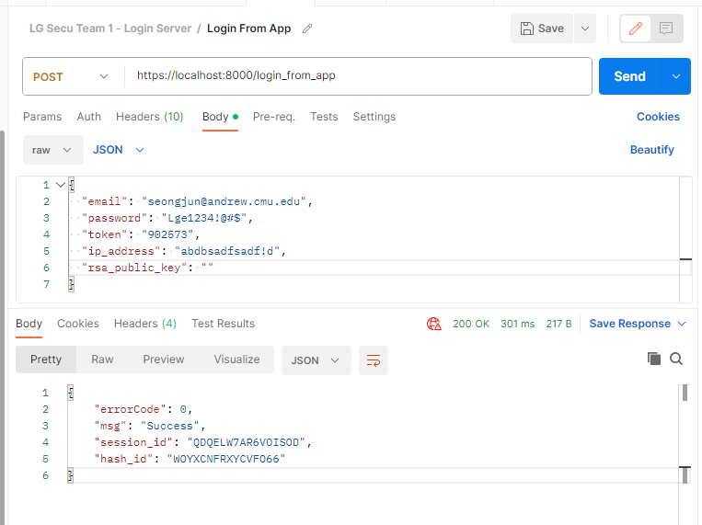
Appendix-16) Attack scenario
Login success with blank rsa_public_key -> Bob can send not encrypted AES key(?) Not sure if we can get AES key which is not encrypted

Slide 35
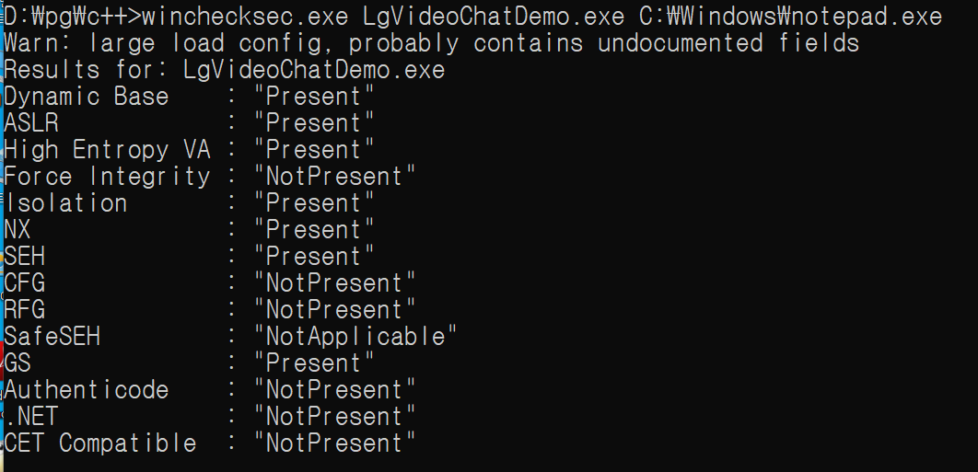
Appendix-17) Client Side attack
test checksec : CFG/RFG disable → ROP Possibile (???)
Scenario 1 :
OpenCV within project source has some critical vulnerabilities ( integer overflow, NULL dereference, use of uninitialized variable)
code injection using step1’s vulnerability
the shell code is to send private key or AES to attacker’s server.
the attacker be able to sniff Video call using the victim’s AES key
Scenario 2:
OpenCV within project source has some critical vulnerabilities ( integer overflow, NULL dereference, use of uninitialized variable)
code injection using step1’s vulnerability
the shell code is to exploit the client’s host system (ex.. to execute powershell with privilege mode)

Slide 36
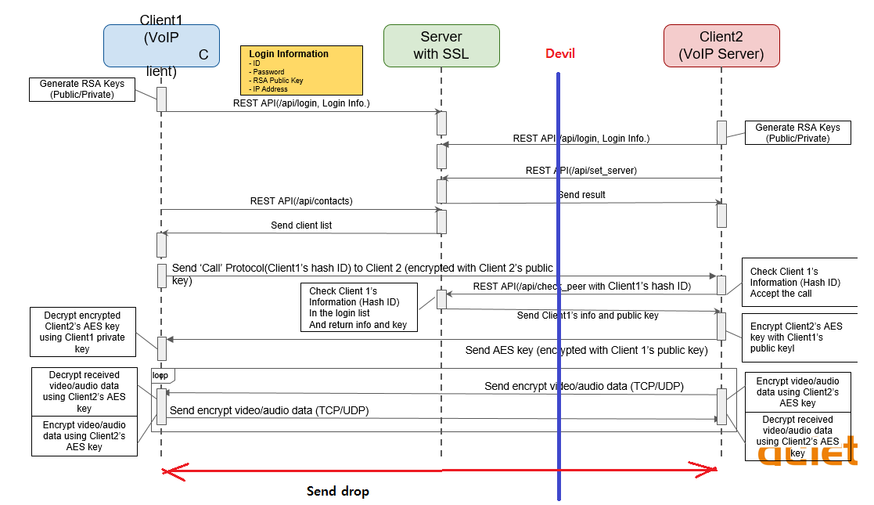
Appendix-18) Unwanted Call Drop via MITM or spoofing

Slide 37
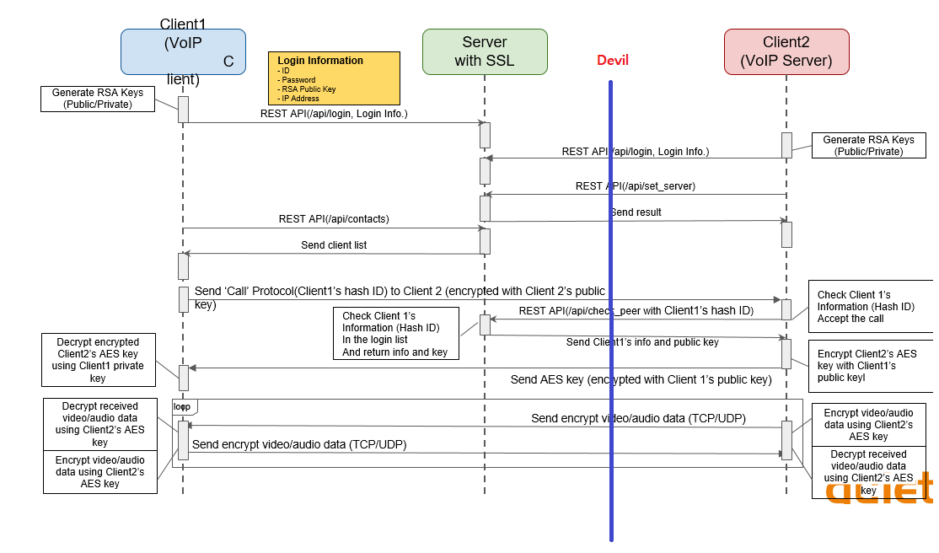
Appendix-19) Sniffing video call via MITM(1)

Slide 38
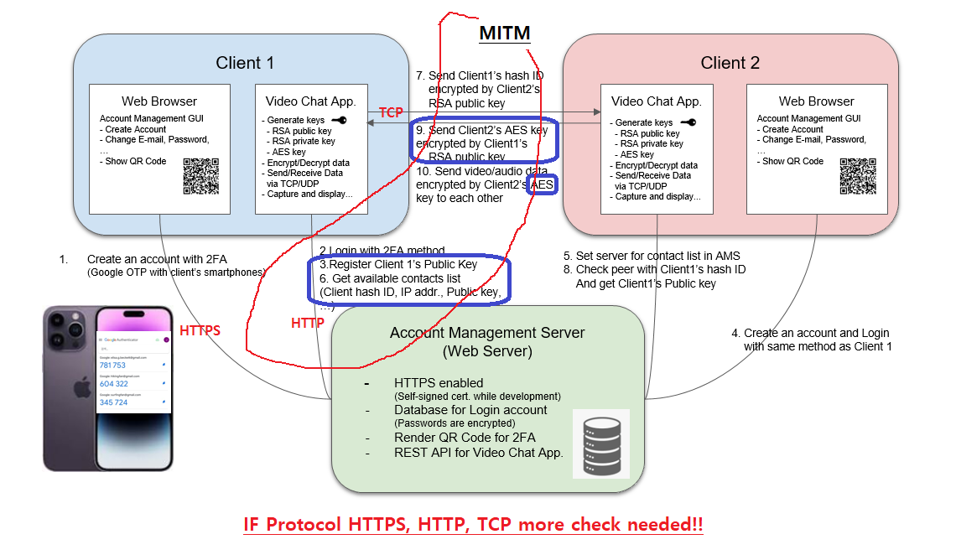
Appendix-20) Sniffing video call via MITM(2)

Slide 39
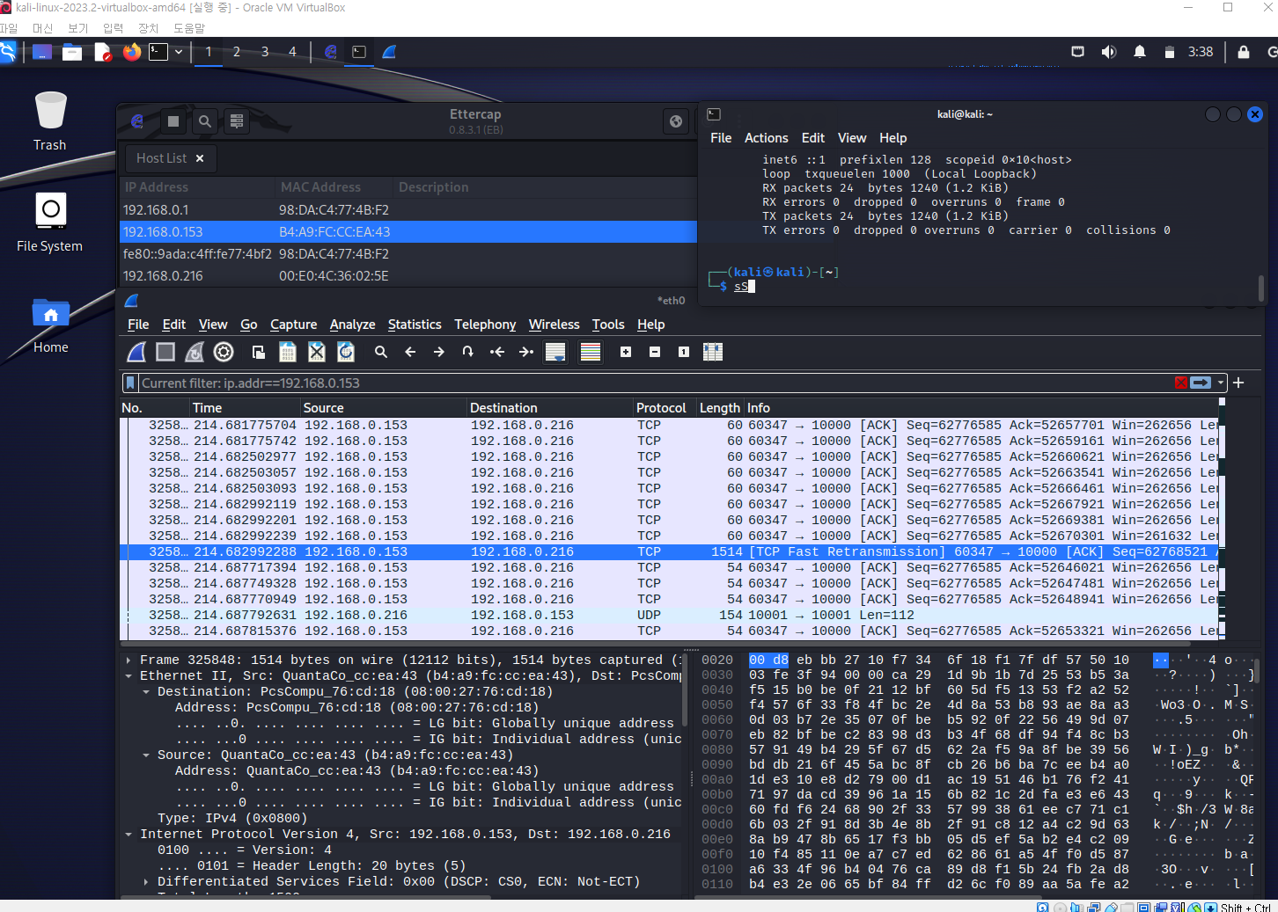
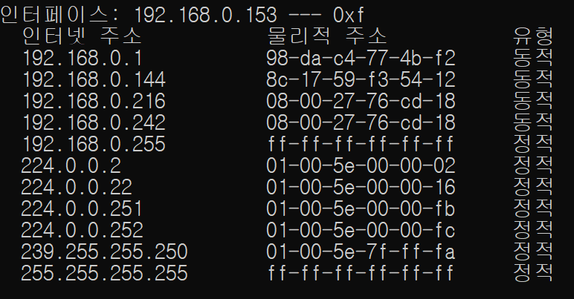
Appendix-21) ARP Spoofing
Attacker changed target’s arp table
Attacker : 192.168.0.242
Target 1: 192.168.0.153
Target 2: 192.168.0.216
Attacker try to sniff packets
Target 1: 192.168.0.153 <-> Target 2: 192.168.0.216

Slide 40
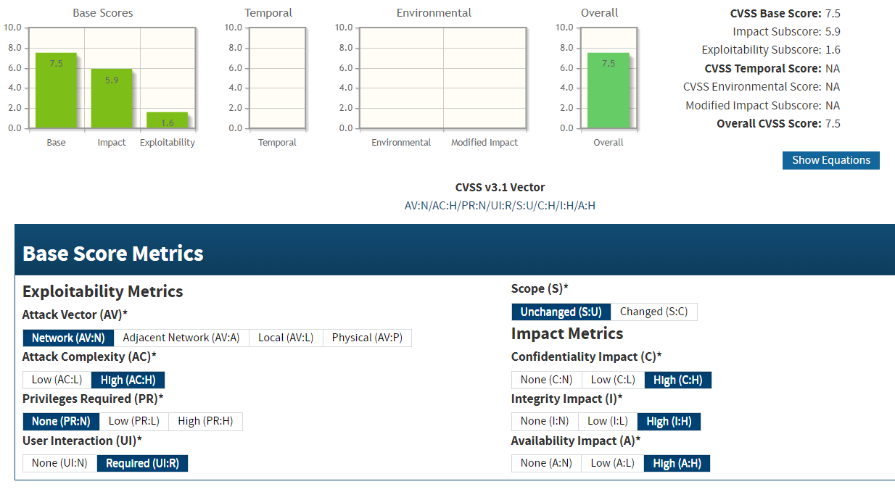
Appendix-22) Common Vulnerability Scoring System
Vulnerability :If hash_id and public key is known, it is possible to make fake call.
https://www.first.org/cvss/specification-document
https://nvd.nist.gov/vuln-metrics/cvss/v3-calculator

Slide 41
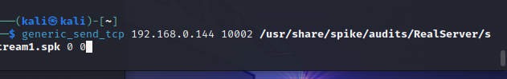
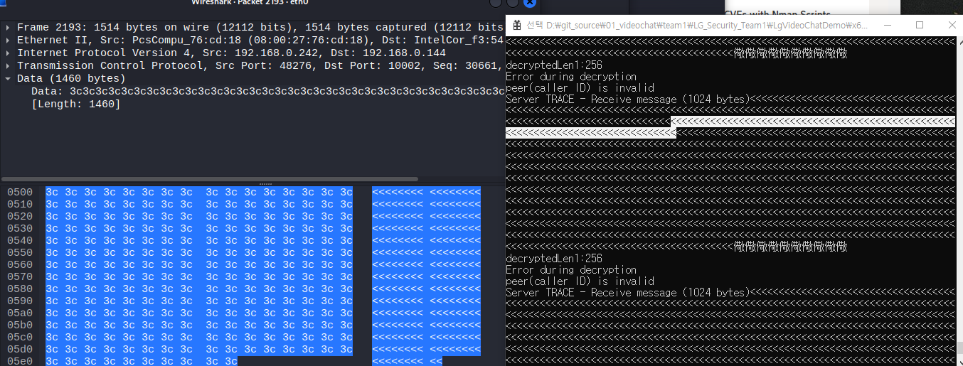
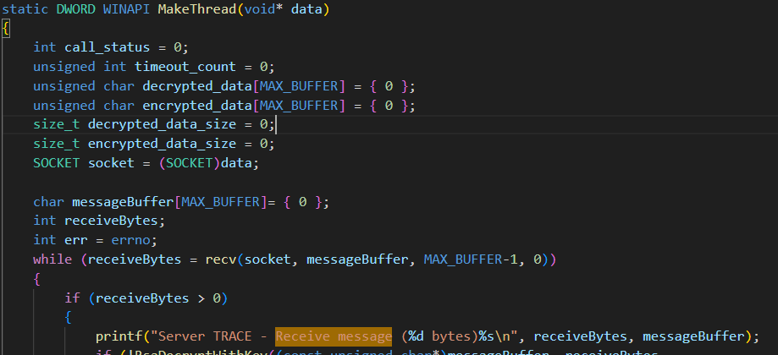
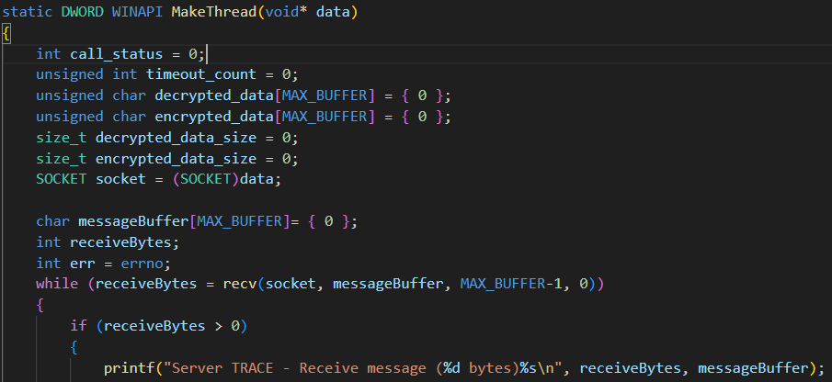
Appendix-23) SPIKE Fuzzing
print garbage data
mesageBuffer is not NULL terminated
Recommend:
messageBuffer initialization
Change receive size

